Slide 1
Pattern Matching
Algorithms & Data Structures
ITCS 6114/8114
Dr. Dewan Tanvir Ahmed
Department of Computer Science
University of North Carolina at Charlotte

Slide 2
Pattern Matching

Slide 3
Outline and Reading
Strings (§9.1.1)
Pattern matching algorithms
Brute-force algorithm (§9.1.2)
Boyer-Moore (BM) algorithm (§9.1.3)
Knuth-Morris-Pratt (KMP) algorithm (§9.1.4)

Slide 4

Strings
A string is a sequence of characters
Examples of strings:
Java program
HTML document
DNA sequence
Digitized image
An alphabet Σ is the set of possible characters for a family of strings
Example of alphabets:
ASCII
Unicode
{0, 1}
{A, C, G, T}

Slide 5
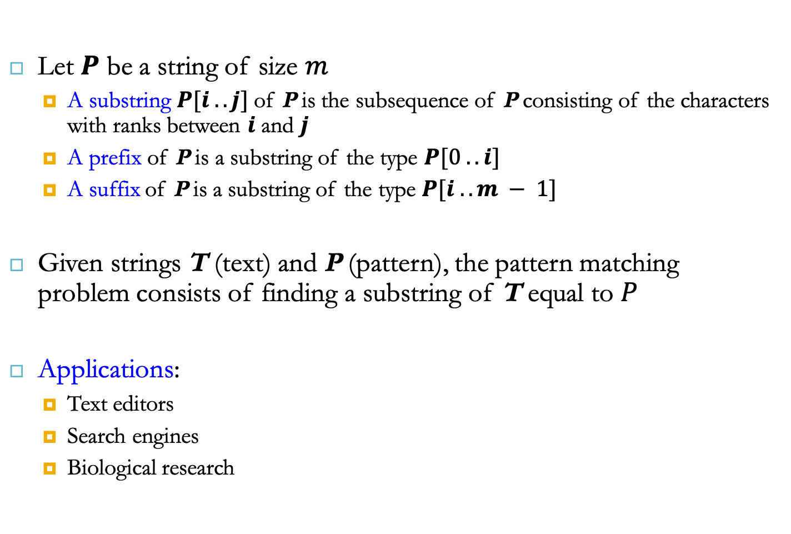
Strings
Let $P$ be a string of size $m$
A substring $P[i .. j]$of P is the subsequence of P consisting of the characters with ranks between $i$ and $j$
A prefix of P is a substring of the type $P[0 .. i]$
A suffix of P is a substring of the type $P[i ..m − 1]$
Given strings T (text) and P (pattern), the pattern matching problem consists of finding a substring of T equal to $P$
Applications:
Text editors
Search engines
Biological research

Slide 6

Brute-Force Algorithm
$\text{The} \text{brute}\text{−}\text{force} \text{pattern} \text{matching} \text{algorithm} \text{compares} \text{the} \text{pattern} \text{P} \text{with} \text{the} \text{text} \text{T} \text{for} \text{each} \text{possible} \text{shift} \text{of} \text{P} \text{relative} \text{to} \text{T}\text{, }\text{until} \text{either}$
a match is found, or
all placements of the pattern have been tried

Slide 7
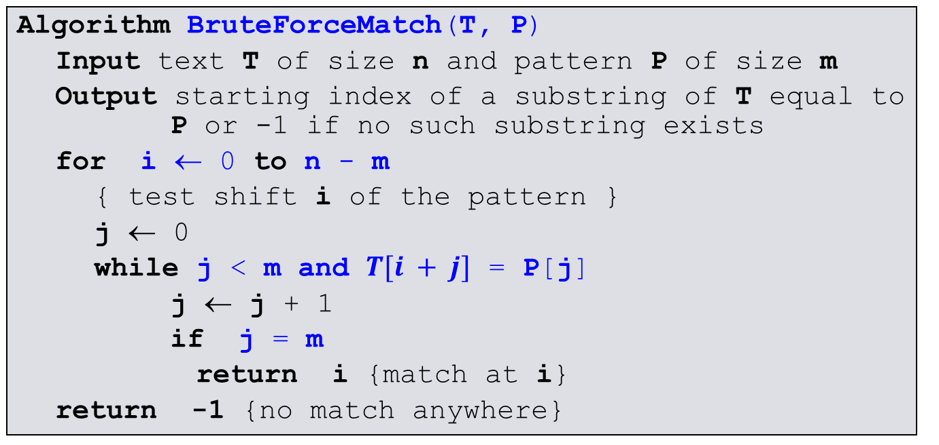
Brute-Force Algorithm
Algorithm BruteForceMatch(T, P)
Input text T of size n and pattern P of size m
Output starting index of a substring of T equal to P or -1 if no such substring exists
for i ← 0 to n - m
{ test shift i of the pattern }
j ← 0
while j < m and $T[i + j]$ = P[j]
j ← j + 1
if j = m
return i {match at i}
return -1 {no match anywhere}

Slide 8

Brute-Force Algorithm
Brute-force pattern matching runs in time $O(nm)$
Example of worst case:
T = aaa … ah
P = aaah
may occur in images and DNA sequences
unlikely in English text

Slide 9












Boyer-Moore Heuristics
The Boyer-Moore’s pattern matching algorithm is based on two heuristics
Looking-glass heuristic: Compare P with a subsequence of T moving backwards
Character-jump heuristic: When a mismatch occurs at T[i] = c
If P contains c, shift P to align the last occurrence of c in P with T[i]
Else, shift P to align P[0] with T[i + 1]
Example

Slide 10
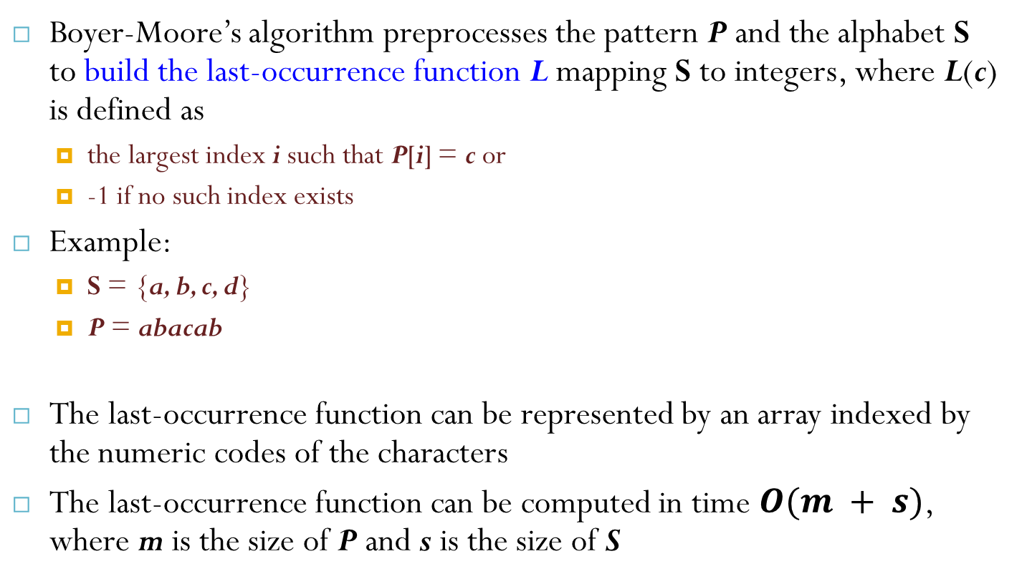
Last-Occurrence Function
Boyer-Moore’s algorithm preprocesses the pattern P and the alphabet S to build the last-occurrence function L mapping S to integers, where L(c) is defined as
the largest index i such that P[i] = c or
-1 if no such index exists
Example:
S = {a, b, c, d}
P = abacab
The last-occurrence function can be represented by an array indexed by the numeric codes of the characters
The last-occurrence function can be computed in time $O(m + s)$, where m is the size of P and s is the size of S
c | a | b | c | d
L(c) | 4 | 5 | 3 | −1

Slide 11
The Boyer-Moore Algorithm
Algorithm BoyerMooreMatch(T, P, S)
L ← lastOccurenceFunction(P, S )
i ← m - 1
j ← m - 1
repeat
if T[i] = P[j]
if j = 0
return i { match at i }
else
i ← i - 1
j ← j - 1
else
{ character-jump }
l ← L[T[i]]
i ← i + m – min(j, 1 + l)
j ← m - 1
until i > n - 1
return -1 { no match }
Case 1: j ≤ 1 + l
Case 2: 1 + l ≤ j

Slide 12
Example

Slide 13
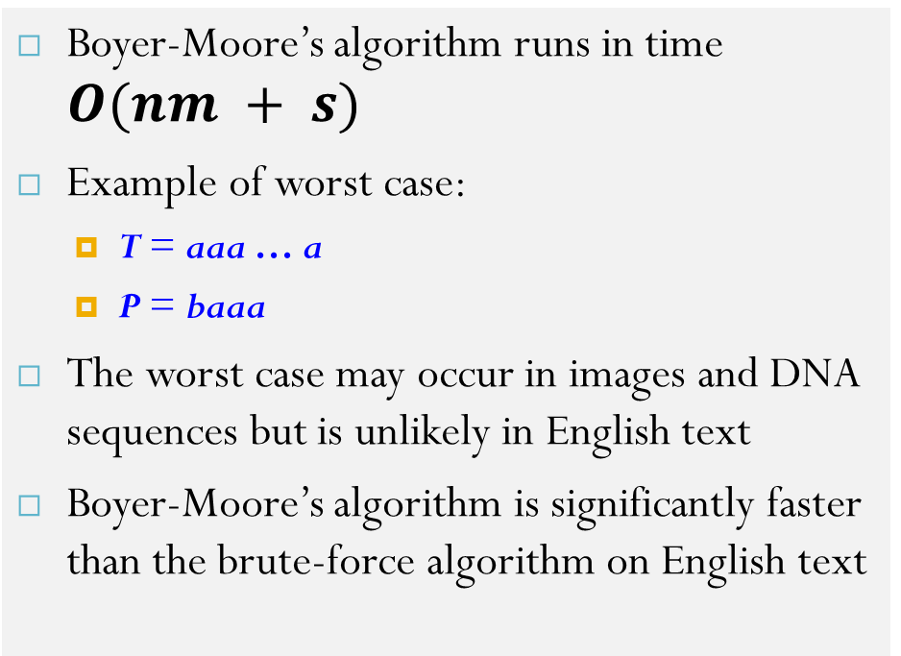
Analysis
Boyer-Moore’s algorithm runs in time $O(nm + s)$
Example of worst case:
T = aaa … a
P = baaa
The worst case may occur in images and DNA sequences but is unlikely in English text
Boyer-Moore’s algorithm is significantly faster than the brute-force algorithm on English text

Slide 14
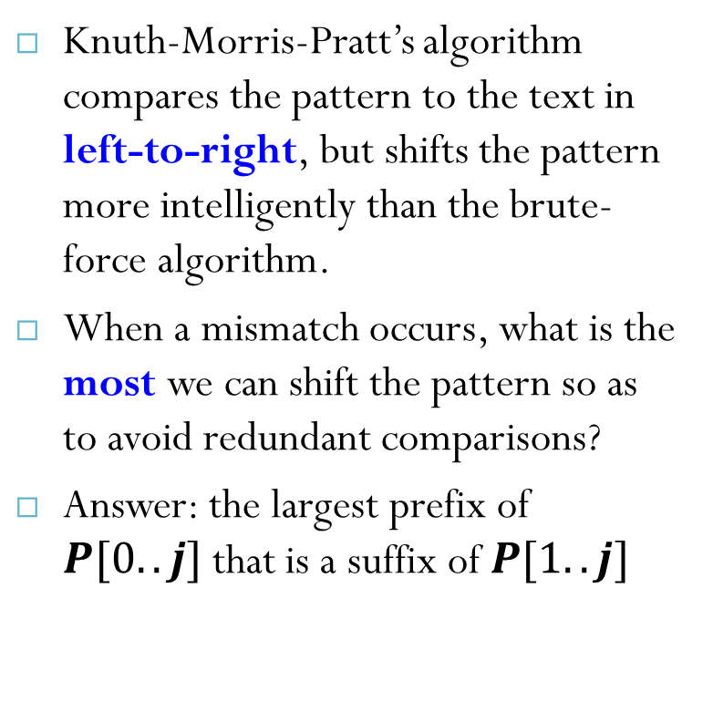
The KMP Algorithm - Motivation
Knuth-Morris-Pratt’s algorithm compares the pattern to the text in left-to-right, but shifts the pattern more intelligently than the brute-force algorithm.
When a mismatch occurs, what is the most we can shift the pattern so as to avoid redundant comparisons?
Answer: the largest prefix of $P[0..j]$that is a suffix of $P[1..j]$
.
.
a
b
a
a
b
x
.
.
.
.
.
a
b
a
a
b
a
j
a
b
a
a
b
a
No need to
repeat these
comparisons
Resume
comparing
here

Slide 15
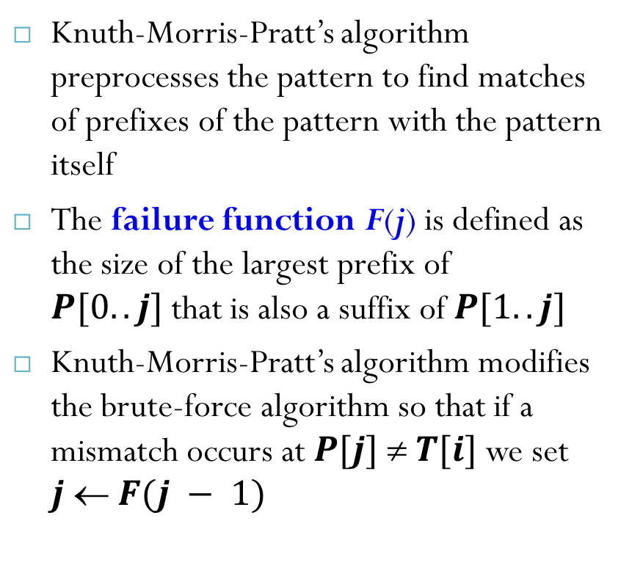
KMP Failure Function
Knuth-Morris-Pratt’s algorithm preprocesses the pattern to find matches of prefixes of the pattern with the pattern itself
The failure function F(j) is defined as the size of the largest prefix of $P[0..j]$that is also a suffix of $P[1..j]$
Knuth-Morris-Pratt’s algorithm modifies the brute-force algorithm so that if a mismatch occurs at $P[j]  T[i]$we set $j  F(j − 1)$
j | 0 | 1 | 2 | 3 | 4 | 5
P[j] | a | b | a | a | b | a
F(j) | 0 | 0 | 1 | 1 | 2 | 3

Slide 16
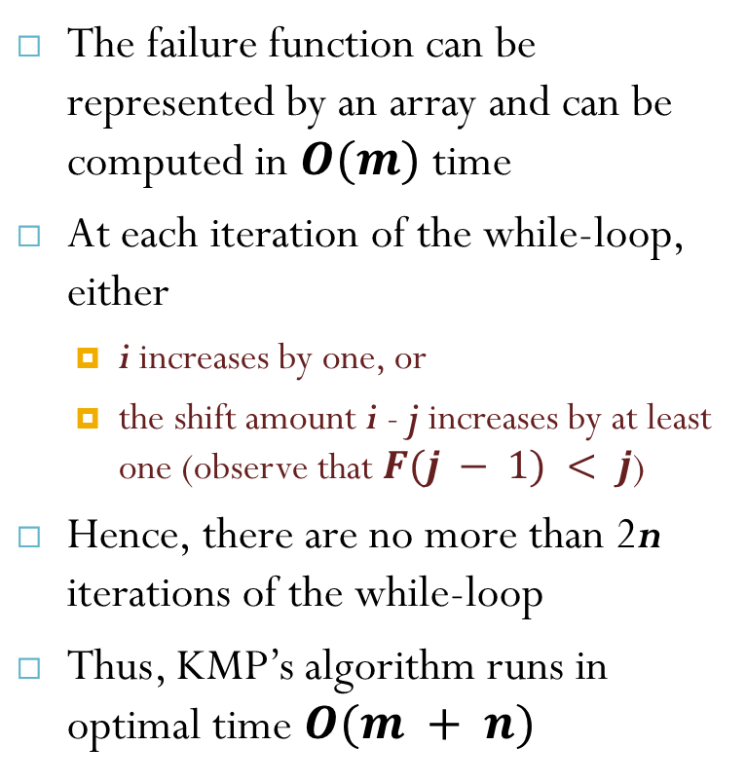
The KMP Algorithm
The failure function can be represented by an array and can be computed in $O(m)$ time
At each iteration of the while-loop, either
i increases by one, or
the shift amount i - j increases by at least one (observe that $F(j − 1) < j$)
Hence, there are no more than 2n iterations of the while-loop
Thus, KMP’s algorithm runs in optimal time $O(m + n)$
Algorithm KMPMatch(T, P)
F ← failureFunction(P)
i ← 0
j ← 0
while i < n
if T[i] = P[j]
if j = m - 1
return i - j { match }
else
i ← i + 1
j ← j + 1
else
if j > 0
j ← F[j - 1]
else
i ← i + 1
return -1 { no match }

Slide 17
Computing the Failure Function
The failure function can be represented by an array and can be computed in O(m) time
The construction is similar to the KMP algorithm itself
At each iteration of the while-loop, either
i increases by one, or
the shift amount i - j increases by at least one (observe that F(j - 1) < j)
Hence, there are no more than 2m iterations of the while-loop

Slide 18
Example
j | 0 | 1 | 2 | 3 | 4 | 5
P[j] | a | b | a | c | a | b
F(j) | 0 | 0 | 1 | 0 | 1 | 2
Notes:
abacaabaccabacabaabb

Slide 19
Reference
Algorithm Design: Foundations, Analysis, and Internet Examples. Michael T. Goodrich and Roberto Tamassia. John Wiley & Sons.
Introduction to Algorithms. Thomas H. Cormen, Charles E. Leiserson, Ronald L. Rivest, Clifford Stein.

Slide 20
Thank you!

